Slide 1
COMP 2920 : Software Architecture & Design

Slide 2
Chapter Topics
Define requirements
Requirements discovery
Domain Analysis

Slide 3
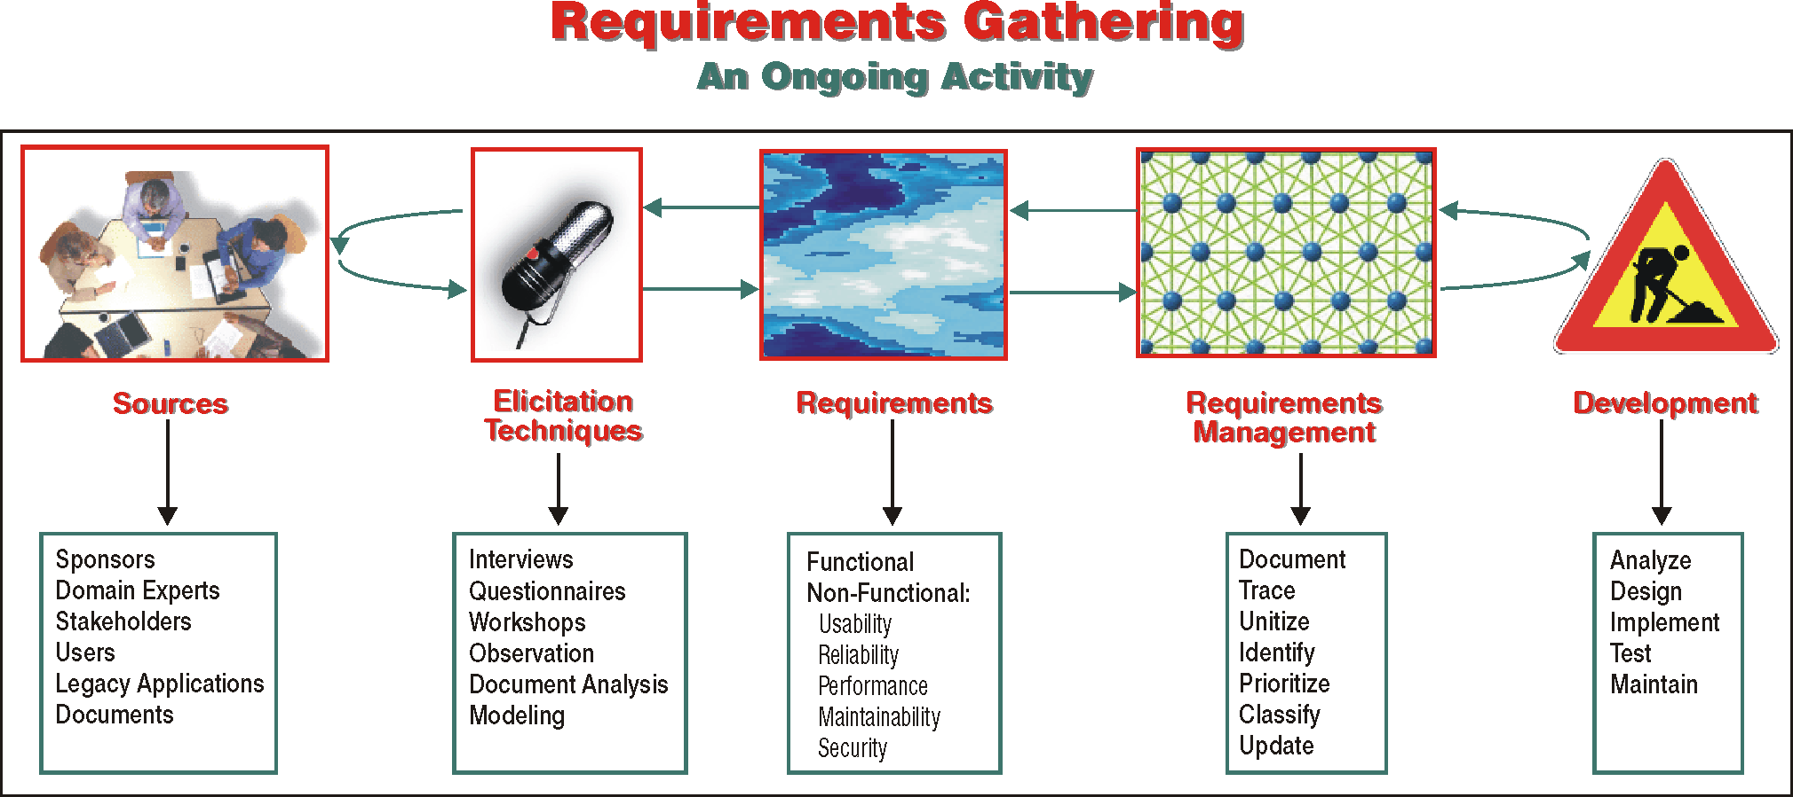

Slide 4
Requirements Gathering
The task of requirements gathering is to collect and define all features that the information system must have in order to fulfill the objectives that the customer has set.
The reliability and the correctness of requirements is dependent on their sources, on the techniques that we employ to elicit and verify them, and on their effective management.

Slide 5
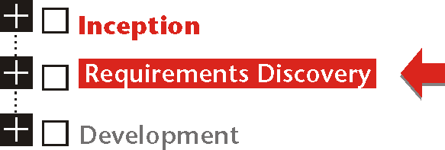
Requirements Discovery

Slide 6
Requirements Discovery
Requirements discovery identifies the scope and the major objectives of the system. Requirements gathering defines what is needed to reach those objectives.

Slide 7
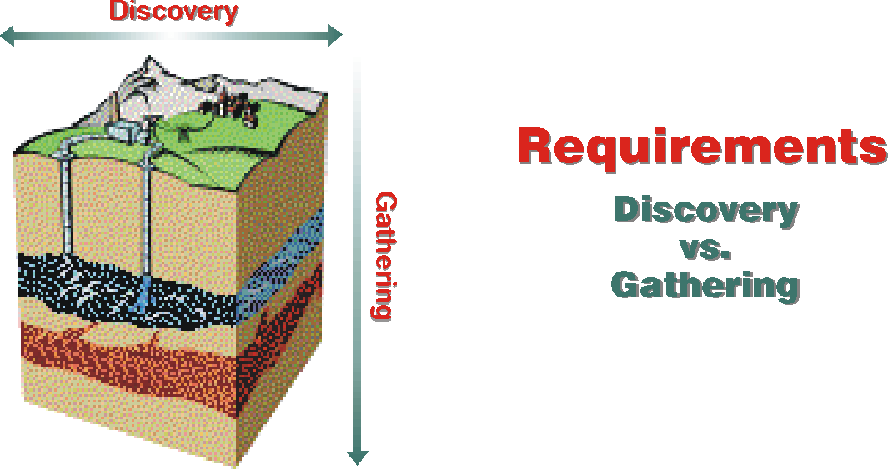

Slide 8
Classifying Requirements
Requirements fall into two broad categories: functional (or behavioral) and non-functional. Since both relate to the same product, they are interrelated and affect each other:
Functional Requirements
Functional requirements specify the behavior of the system and the constraints on that behavior.
Non-Functional Requirements
Non-functional requirements specify non-behavioral properties of the system and the constraints on those properties.

Slide 9
Non-Functional Requirements
Usability
Reliability
Performance
Maintainability
Security

Slide 10
Techniques for Eliciting Requirements
Interviews
Questionnaires
Elicitation Workshops
Field Trips and Observation
Modeling
Mock-Ups

Slide 11
Managing Requirements
❶ Document and update requirements
❷ Document sources
❸ Separate requirements into distinct units
❹ Uniquely identify each requirement
❺ Verify requirements and document verifications
❻ Prioritize requirements
❼ Classify requirements meaningfully

Slide 12
Domain Analysis
Domain analysis identifies business concepts that will be refined into the building blocks of an analysis model for the information system.

Slide 13
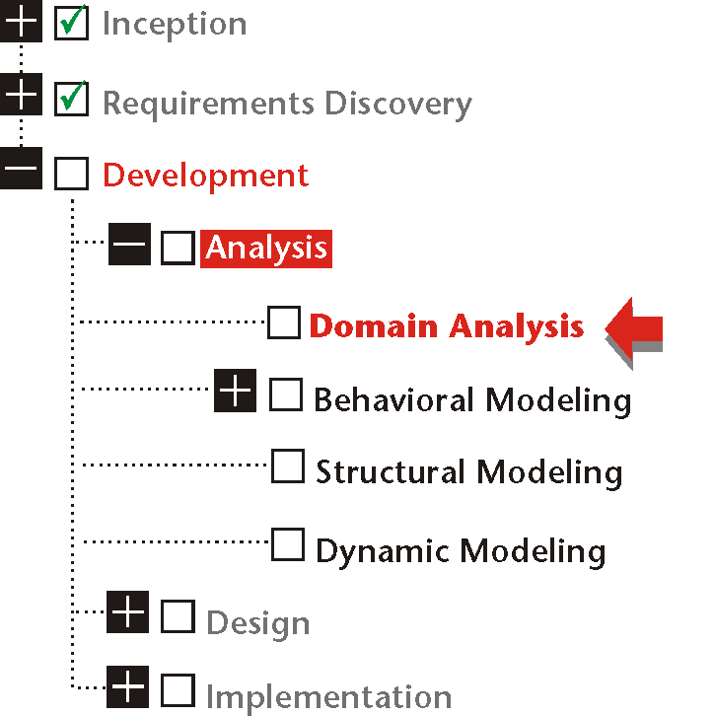
Domain Analysis and Development

Slide 14
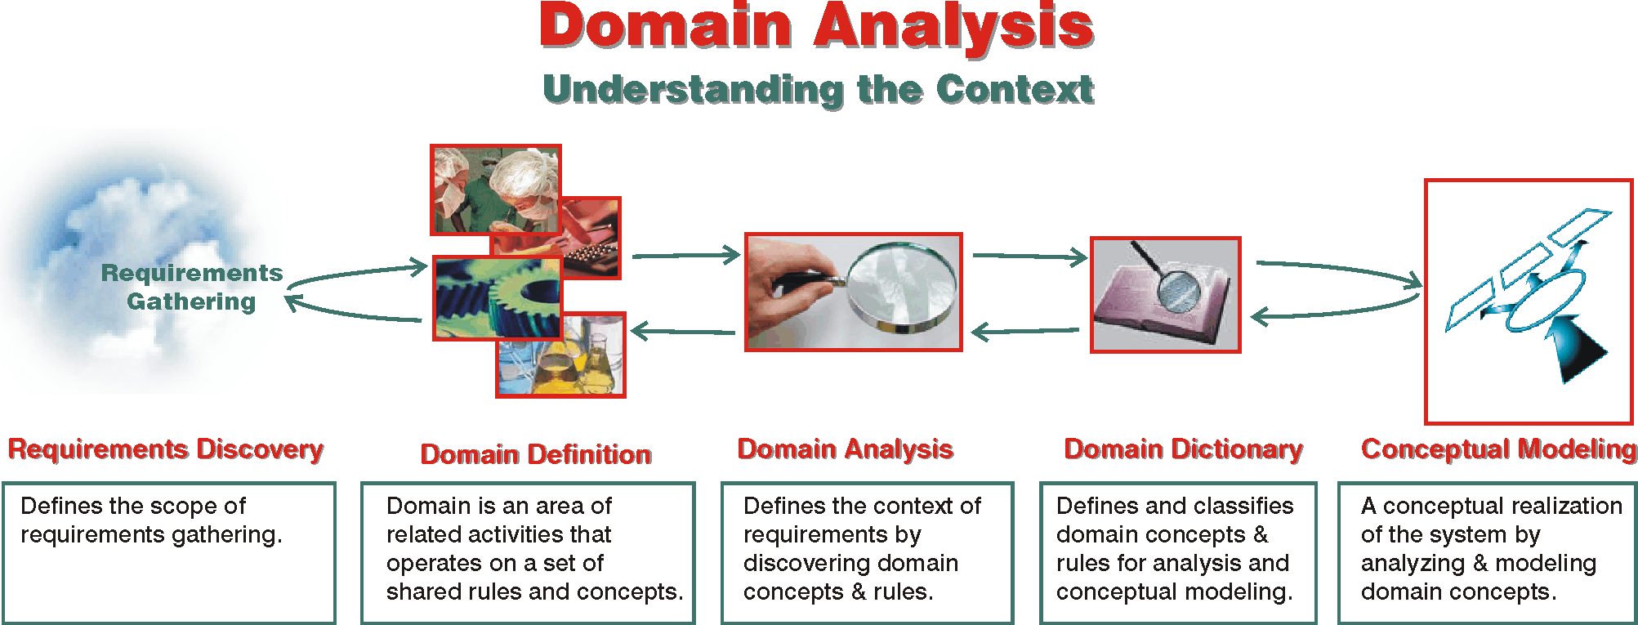

Slide 15
Problem Space Versus Solution Space
The three components of problem solving reside in two organically related spaces: the problem space and the solution space. Changing an element within one space has a ripple effect across both.

Slide 16
Problem Space
Problem space is the context from which the problem arises and in which the solution must operate.

Slide 17
Solution Space
Solution space defines the territory in which concrete decisions about the information system — as opposed to its features — are made.

Slide 18
Requirements Versus Product Specifications
Requirements specify the desired features of the product or service.
Product specifications define the product that must realize those features.

Slide 19
Domain Definition
A business domain is an area of related activities that operate on a set of shared rules and concepts:
Business domains are organized domains.
Business domains are goal-oriented.
Business domains can change fast.

Slide 20
The Domain Scope
Domain scope defines the boundaries that separate shared activities, rules and concepts within a domain from those on the outside.

Slide 21
Domains and Subsystems
Domain definition provides a framework for the conceptual subsystems within the information system.

Slide 22
Walden Medical Center: Domain Definitions (Partial Listing)
Domain | Scope Outline
Patient Management: | All activities that directly come into contact with patients fall within this domain, including: Referrals Scheduling Registration, Admissions Treatments Patient Billing Issues
Drug Inventory & Purchasing: | Pharmaceutical Inventory Drug Supply Chain
… | …
Medical & Lab Technology: | Medical Equipment Purchasing Medical Equipment Inventory Medical Equipment Maintenance
House Services: | Laundry Cleaning Food Preparation & Diets
… | …

Slide 23
Domain Analysis
Domain analysis is analyzing the context of requirements. It has a two-fold task:
define the context in which the information system will operate.
discover and define concepts that the product must incorporate or take into account in order to meet its objectives.

Slide 24
Finding Domain Concepts
Domain concepts are objects, processes, people and rules that constitute the goals, the behavior and the structure of a domain.

Slide 25
Finding Domain Concepts
Discover the essence of the requirements.
Discover problems that the requirements are supposed to solve.
Discover the components of the problem.
Discover related domain concepts.

Slide 26
Domain Dictionary
Domain dictionary organizes and brands domain concepts. It is the link between stakeholders who must verify the concepts and the analysts who would use them as the foundation for building a conceptual model of the system.

Slide 27
Domain Dictionary
The dictionary organizes domain concepts (the problem space) pertinent to the system (the solution space).
To populate the dictionary, we turn to all the products of information gathering: requirements, interviews, manuals.

Slide 28
Domain Dictionary
The most promising concepts are:
Subjects
“The noun, noun phrase, or pronoun in a sentence or clause that denotes the doer of the action.”
Objects
“a. A noun or substantive that receives or is affected by the action of a verb within a sentence. b. A noun or substantive following and governed by a preposition.”
These nouns are candidates for becoming objects in an object-oriented sense.
Verbs
They can indicate processes, but they can also hide nouns, or grammatical objects: “ordering a book” is a variant of “placing an order for book.” The object “order” is hidden in the verb “order.”

Slide 29
Domain Dictionary An Example
Medical Service. Depending on the nature of the medical service, doctors, nurses and lab technicians provide the patient with appropriate service (s) for which the appointment has been made.

Slide 30
The Dictionary Template
Name
Type
Description
Source
Notes

Slide 31
Business Rules
Business rules are a set of detailed policies, laws, procedures, guidelines and standards under which an enterprise operates. A business rule is a statement that defines or demands adherence to a unit in the set.

Slide 32
Classification of Business Rules
Classification helps us to correctly incorporate business rules in the design and the implementation of an information system.

Slide 33
Managing Business Rules
Business rules must be organized, maintained and verified for the life of a business, not for the duration of an application.

Slide 34
Rules Dictionary
Requirements specify features of the product, while business rules apply beyond any single solution.

Slide 35
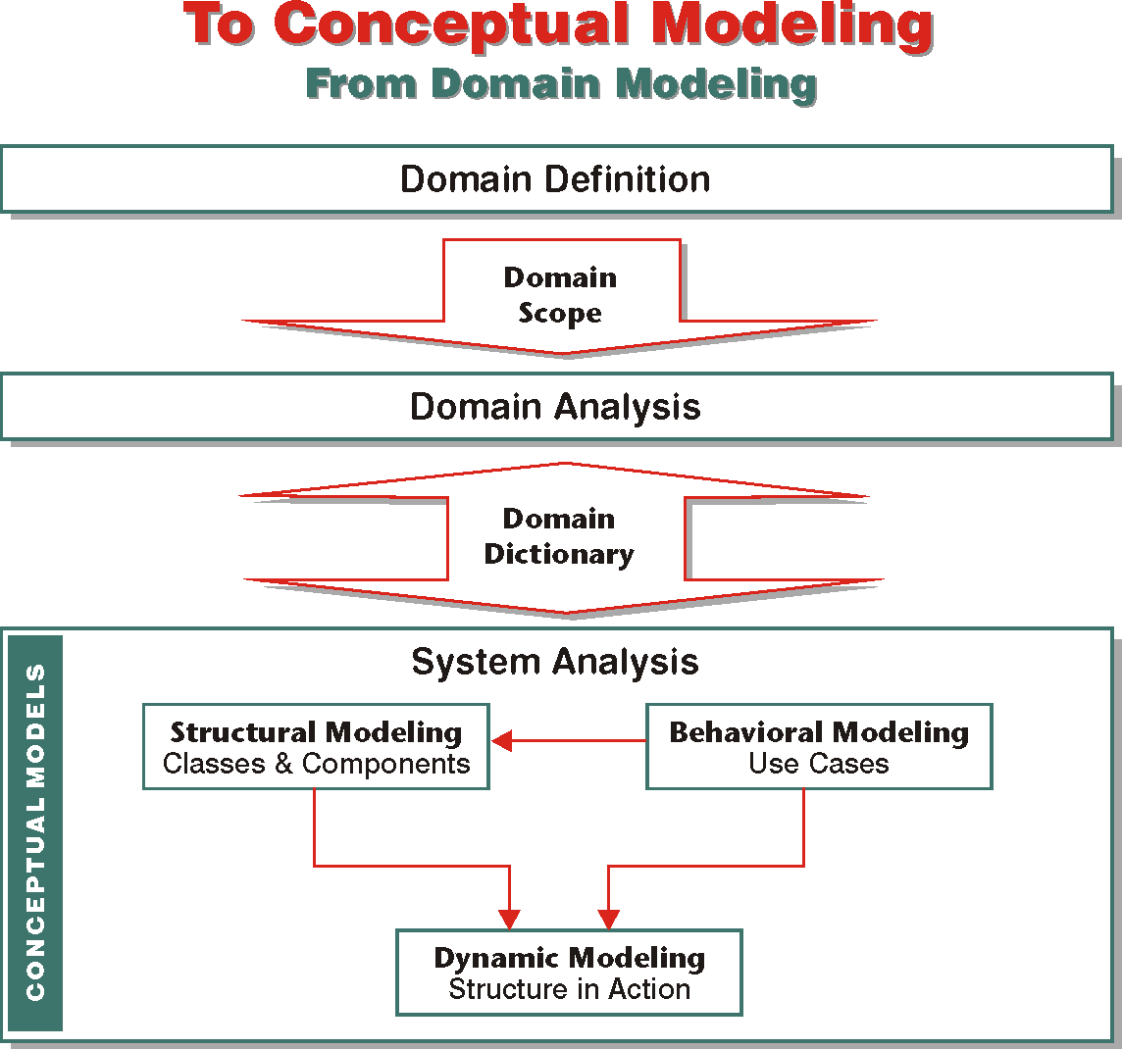
Next: Conceptual Modeling

